Slide 1


HTML5

Slide 2

Topics Covered
Introduction to HTML5
Features of HTML5
Introduction to semantic tags (nav, header, section, footer, main..)
Benefits of using semantic tags

Slide 3

Introduction to HTML5

Slide 4
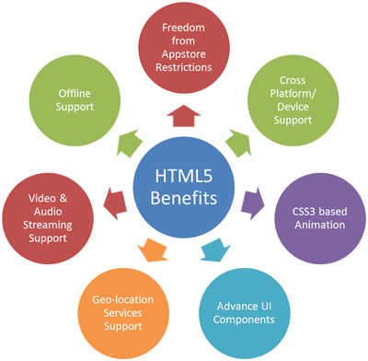
Features of HTML5

Slide 5
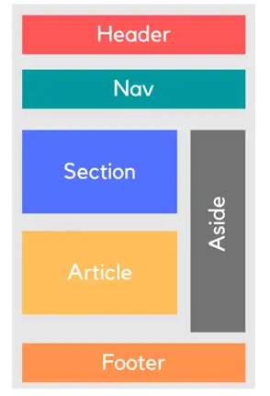
Introduction to semantic tags

Slide 6



Benefits of using semantic tags
Logical HTML Code
Helps Screen Reader
Improves SEO

Slide 7

THANK YOU

